Slide 2
European Centre for Disease Prevention and Control & European Monitoring Centre for Drugs and Drug Addiction
Public health guidance on prevention and control of communicable diseases in prison settings
Dagmar Hedrich, Public Health Unit, EMCDDA –
Harm reduction for people who inject drugs in Europe: findings from the European Joint Action HA-REACT - AIDS2018 Satellite Symposium - 23 July 2018, Amsterdam

Slide 3
Dagmar Hedrich
No conflict of interest to declare

Slide 4
Rationale
600.000 people in prison in the EU/EEA
High burden of BBV among prisoners
Prevalence HCV, HBV, HIV multiple times higher than general population
Setting of increased risk of BBV transmission
Strong association prison history and BBV infection in PWID
Complex health and care needs of people in prison
Opportunity to address healthcare needs of groups medically underserved in the community.

Slide 5
Guidance on prevention and control of communicable diseases in prison settings
Aim: Develop an evidence-based public health guidance on prevention and control of communicable diseases in prison settings
Scope: Improve prevention and control of communicable diseases in prison setting by identifying effective (cost-effective) interventions and service models
Audience: Policy makers, policy advisors, programme managers, professionals involved in national guidelines/guidance development, service providers
Population: People in prison [>18 years]

Slide 6
Project governance and key actors
ECDC
Consortium Pallas Health Research and Consultancy & Health Without Barriers
EMCDDA
Ad hoc scientific Panel
MS Public Health bodies
MS Ministry of Health or Justice
CSOs
Intern. agencies: WHO, UNODC
Joint Action/ EU projects
Health care workers

Slide 7
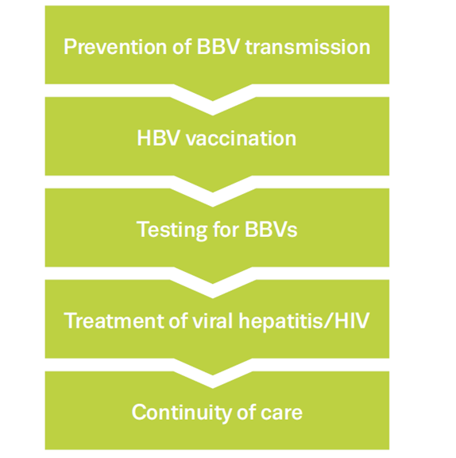
Equivalence of care

Slide 8
Systematic search

Slide 9
Prevention
Offer a comprehensive package of preventive measures to people in prison that meet the same national standards as those recommended for community settings.
Evidence shows that also in prison settings, condoms and behavioural interventions promote safer sex.
Evidence shows that opioid substitution treatment reduces illicit opioid use and risks related to equipment sharing and, when continued on release, provides protection from death caused by overdose.
Evidence shows that the provision of clean drug injection equipment is possible in prison settings and can successfully contribute to a comprehensive programme to reduce BBV transmission.

Slide 10
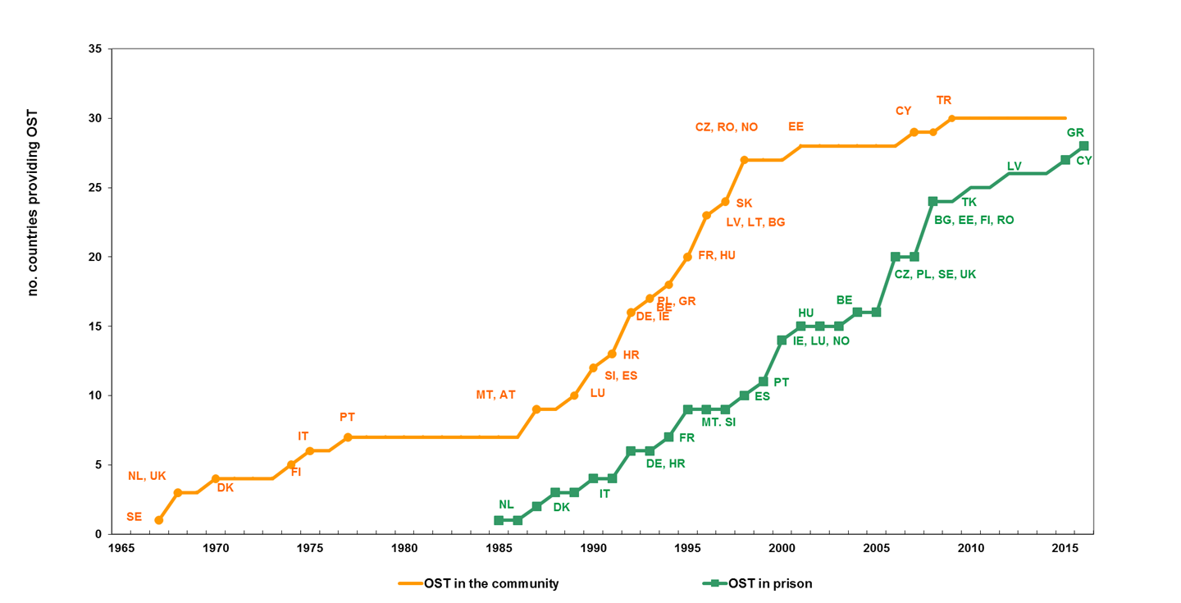
Opioid substitution treatment in prison
Delayed OST introduction in prison settings in EU
26 countries provide OST in continuation if treatment started outside
Some do not allow initiation
Prison OST guidelines in 11 countries
Source: EMCDDA Reitox Focal Points

Slide 11
HBV vaccination
Offer HBV vaccination to people in prison with unknown or negative serology.
Evidence shows that using rapid schedules may result in a higher completion rate of the full schedule.

Slide 12
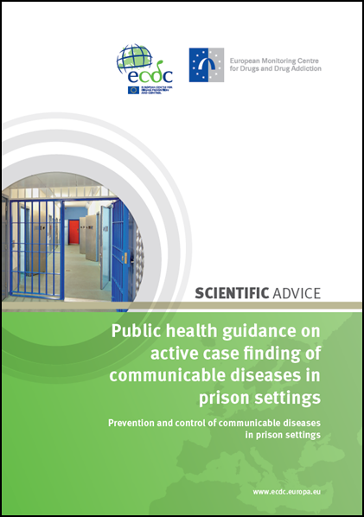
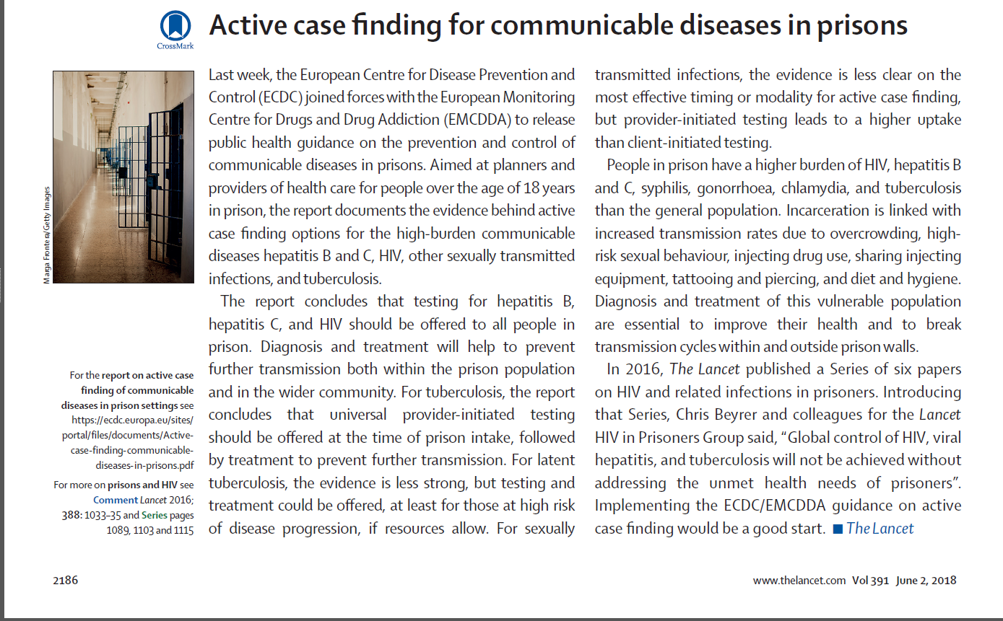
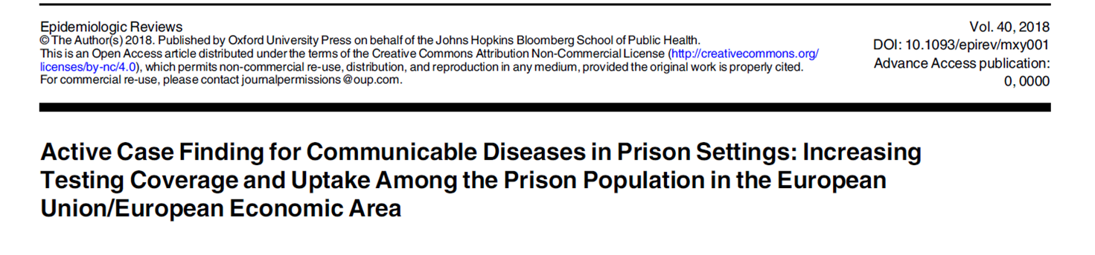
Testing for viral hepatitis and HIV
Actively offer BBV testing to all people in prison upon admission and throughout the time in prison.
Evidence shows that pro-active provision of BBV testing leads to a higher uptake; health promotion and peer education have been shown to increase HIV testing uptake.
See also detailed guidance
published in May 2018:

Slide 13
Viral hepatitis and HIV treatment
Offer appropriate treatment to individuals diagnosed with HIV, HBV or HCV infection in prison settings, in line with the guidelines applied in the community and meeting the same provision standards as in the community.
Evidence shows that treatment of BBV infections is feasible and effective in prison.

Slide 14
Continuity of care
Actively support and ensure continuity of care between prison and community.
Evidence shows that release from prison is a key barrier to continuity and adherence to drug and infectious diseases treatment.
Evidence shows that collaboration and partnership between prison and community health-care services promote and facilitate uninterrupted care.
Evidence shows that active referral to external services improves treatment adherence.

Slide 15
The role of monitoring
Prison health is public health
Monitoring essential to support policy and practice decisions
Standardised tools to monitor and report epidemiological situation and health response available
Integration with wider national health monitoring beneficial

Slide 16
Need for more research
Limited published research to confirm evidence-based interventions
Grey literature and unpublished research remain fundamental source, but impose limitations
Research on effective service delivery models lacking
ECDC, EMCDDA and WHO resources available

Slide 17
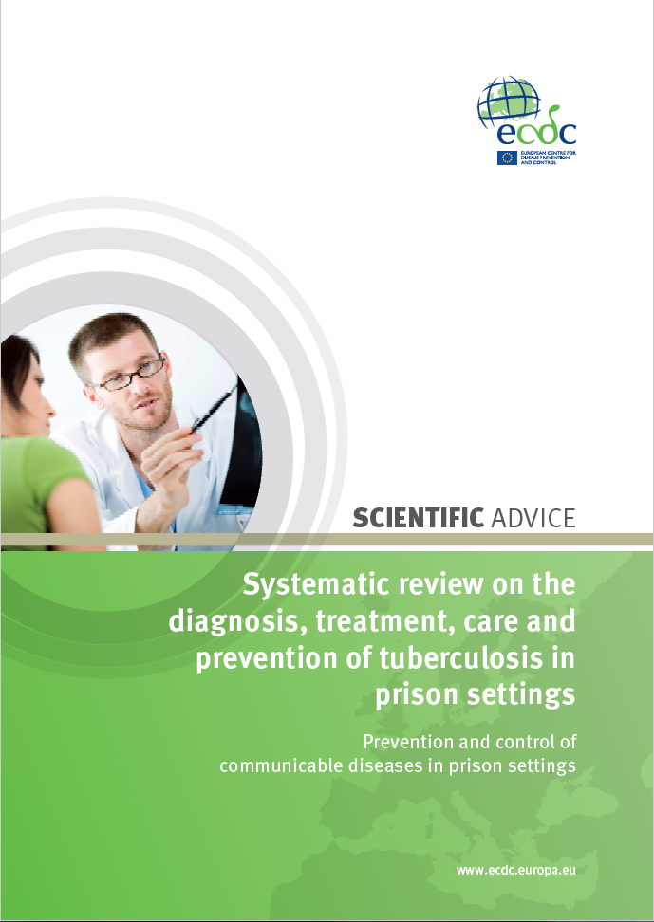
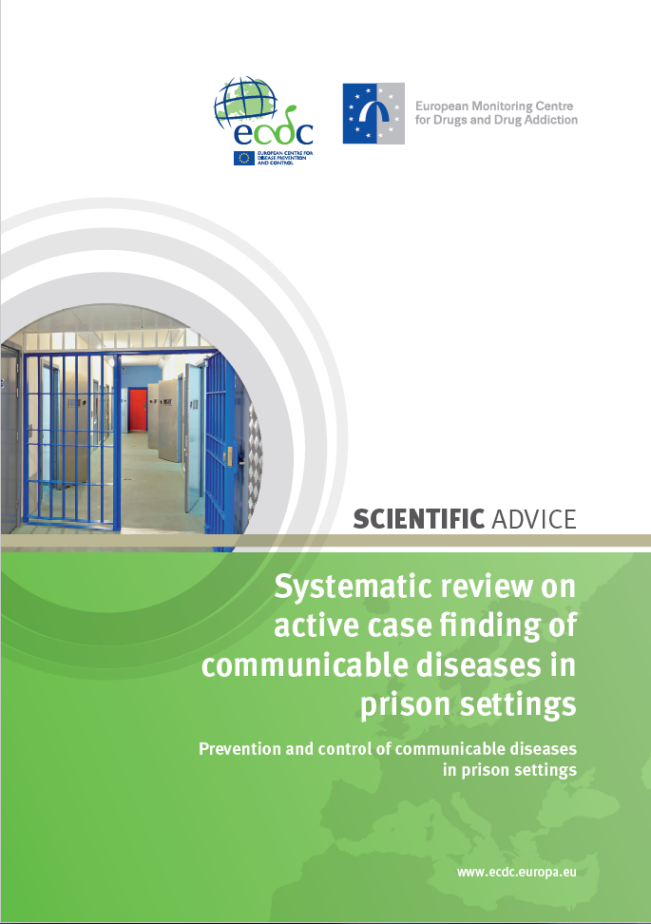
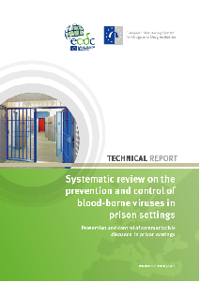
Online resources: systematic review reports
https://ecdc.europa.eu/en/publications-data/systematic-review-active-case-finding-communicable-diseases-prison-settings
https://ecdc.europa.eu/sites/portal/files/documents/Systematic-review-tuberculosis-in-prisons-May2017.pdf
http://www.emcdda.europa.eu/publications/joint-publications/ecdc/systematic-review-blood-borne-viruses-in-prison_en

Slide 18
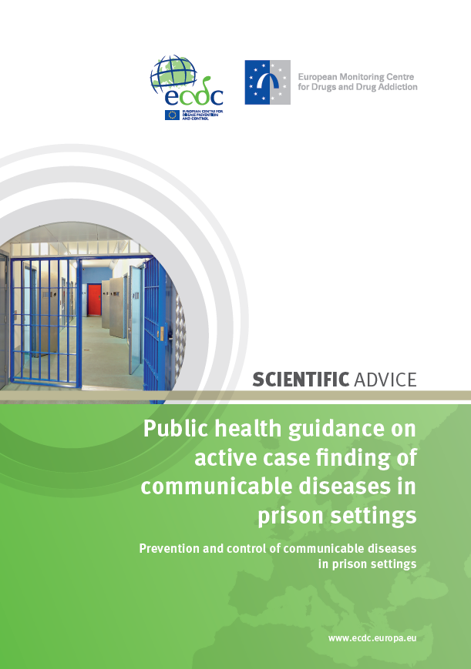

Online resources: guidance documents
https://ecdc.europa.eu/en/publications-data/public-health-guidance-active-case-finding-communicable-diseases-prison-settings
http://www.emcdda.europa.eu/publications/joint-publications/ecdc/guidance-blood-borne-viruses-in-prison_en

Slide 19
Acknowledgements
ECDC
Lara Tavoschi Netta Beer
Andrew Amato Erika Duffell
Marieke van der Werf Anastasia Pharris
Helena de Carvalho Gomes Gianfranco Spiteri
EMCDDA
Dagmar Hedrich
Linda Montanari
Marica Ferri
PROJECT CONSORTIUM
Pallas Health Research and Consultancy: Anouk Oordt, Marije Vonk-Noordegraaf and Hilde Vroling
Health Without Barriers: Letizia Bartocci and Roberto Monarca
Università degli Studi di Sassari: Sergio Babudieri and Giordano Madeddu
Field researchers: Sofia Victoria Casado Hoces, Ruth Gray, Deborah Iwanikow, Leon Weichert
EXPERT PANEL
Chair: Éamonn O’Moore (UK)
Members: Barbara Janíková and Viktor Mravcik (Czech Republic), Kristel Kivimets (Estonia), Fadi Meroueh and Laurent Michel (France), Heino Stöver, Peter Wiessner and Ruth Zimmerman (Germany), Roberto Ranieri (Italy), Erica Cardoso, Rui Morgado (Portugal), Lucia Mihailescu (Romania), Jose-Manuel Royo (Spain), Stefan Enggist and Hans Wolff (Switzerland), Sharon Hutchinson (UK), Alison Hannah (Penal Reform International), Jan Malinowski (Council of Europe), Heino Stover (HA-REACT), Lars Møller (WHO), Ehab Salah (United Nations on Drugs and Crime)

Slide 20
www.ecdc.europa.eu www.emcdda.europa.eu
Thank you
Notes:
20

Slide 21
Prevention of Hep & HIV in prison settings – findings from research
The body of evidence on Hep/HIV prevention in prison settings is limited and restricted to some of the existing preventive measures.
Intervention description | Studies included | Outcome 1: Sero­conversion | Outcome 2: behaviour change | Other outcomes | Level of evidence
Condom distribution EU/EEA (0) | N=1 study; Cross-sectional [Dolan, 2004], sample size (606) | NR | 52%, 28% reported always using condom for anal and oral intercourse, respectively | Use condom machine: 28% Use condoms for sex: 40% | Very low
Safe tattooing program EU/EEA (1) | N=1 study; conference abstract [Humet, 2012], sample size [90] | NR | 68% of those who requested, performed safe tattooing (69.5% had previously been tattooed) | 66% requested safe tattoos | -
Group behaviour/skills-building intervention EU/EEA (0) | N=2 studies; RCT [Lehman, 2015; St Lawrence, 1997], sample size [1257; 90] | NR | Greater improvement in intervention group for some indicators, e.g. HIV knowledge confidence, avoiding risky sex, avoiding risky drug use, | NR | Low

Slide 22
Prevention of Hep & HIV among PWID in prison settings – findings from research
The body of evidence on Hep/HIV prevention targeting PWID in prison settings is limited
Intervention description | Studies included | Outcome 1: Sero­conversion | Other outcomes | Level of evidence
Needle and syringe programmes EU/EEA (3) | N=3 study; 3 longitudinal studies [Stark, 2006; Heinemann, 2001; Arroyo, 2015]; sample size (174; 231; NR) | *HCV: 4 out of 22 HCV (IR 18/100 person-years); *No seroconversions were observed during the intervention period *Between 1998 and 2014 the prevalence of HCV and HIV infection in Spanish prison system decreased from 48.6% to 20% and from 12% to 5.8%, respectively. Temporal association, causality not assessed. | No adverse events reported | All very low
Opioid substitution treatment EU/EEA (0) | N=2 study; 2 RCTs [Dolan, 2003; Dolan, 2005], sample size [both studies 191 OST, 191 control] | *4-month follow up: HIV: 0 at baseline and follow-up; HCV: 4 out of 32 OST and 4 out of 35 control *4.2-year follow up: HIV: IR 0.276/ 100 person-years, 95% CI 0.033-0.996 HCV: IR 21.3/100 person-years, 95% CI 15.6-29.2 | No adverse events reported Increased risk of HCV seroconversion: periods of imprisonment of <2 months (p≤0.001), OST periods of <5 months (p=0.01) | All very low

Slide 23
HBV vaccination in prison settings – findings from research
The body of evidence on effectiveness of HBV vaccination strategies in prison settings is limited
Intervention description | Studies included | Outcome 1: Acceptance | Outcome 2: Uptake | Level of evidence
Standard schedule [0, 1, 6 months] | N=2 studies; 1 cross-sectional [Devine, 2007], sample size [391]; 1 unpublished research report [Gabbuti 2014], sample size [1408-2376] EU/EEA (1) | 83% 12.9% (2009)-24.3% (2014) | Dose 1: 43% Dose 2: 48% Dose 3: 19% Dose 3: 76.1% (35/46) in 2009 – 51.7% (185/358) in 2014 | Very low
Very rapid schedule Vs Standard schedule | N=1 study; 1 RCT [Christensen, 2004], follow-up [NR], sample size [72] EU/EEA (1) | 100% | Very rapid vs Standard (Dose 3): 63% vs 20% Difference in uptake was significant (p=0.017) | Very low
Very rapid schedule [0, 7, 21 days; booster 12 months] | N=3 studies; 1 longitudinal (HBV vaccine) [Christensen, 2004], follow-up [NR], sample size [566] 2 cross-sectional (one with HAV/HBV combined vaccine) [Gilbert 2004; Costumbrado, 2012], sample size [1363; 4719] EU/EEA (2) | 100%; NR (HBV) 34% (HAV/HBV offered to MSM only) | HBV Dose 1: 100%; NR Dose 3: 81%; 29% Booster: 42%; 6%-24% HAV/HBV Dose 1: NR Dose 2: 77% Dose 3: 58% Booster: 11% | Low/very low

Slide 24
HCV treatment in prison settings – findings from research
The body of evidence on HCV treatment in prison settings is largely limited to IFN-based regimens
Intervention description | Studies included | Outcome 1: SVR | Outcome 2: Treatment completion | Level of evidence
Comparison community-based vs. prison-based treatment (IFN-based regimen) EU/EEA (1) | N=2 studies 1 matched cohort [Aspinall, 2016]; sample size [1428] 1 comparative [Rice, 2012], sample size [553] | - People in prison: 42.9%-73.6% - Community: 38.0%-62.9% No significant difference | - People in prison: 75.0%-73.5% - Community: 86.6% No significant difference | Moderate; low
Provision of second generation DAAs EU/EEA (7) | N=7 studies 5 conference abstracts [Touzón-López, 2016; Jiménez-Galán, 2016; Mínguez-Gallego, 2016; Fernàndez-Gonzàlez, 2016; Pontali, 2017]; 2 unpublished reports [Michel, 2017, Meroueh, 2017], sample size [207; 50; 40; 83; 142; 23; 141] | 85.0%-94.7% | 90.0%-95.5% | -
Comparison DOT vs. SAT (IFN-based regimen) EU/EEA (0) | N=2 studies; 1 RCT [Saiz de la Hoya, 2014], sample size [244]; 1 conference abstract [Saiz de la Hoya, 2010], sample size [244] | Overall: 63.5%, 62.2% - DOT: 60.6%, 58.5% - SAT: 65.9%, 65.9% No significant difference | Overall: 83.0%, 79.8% | Low

Slide 25
HIV treatment in prison settings – findings from research
The body of evidence on HIV treatment in prison settings is sizeable
Intervention description | Studies included | Outcome 1: Adherence | Outcome 2: Viral suppression | Level of evidence
Usual care - Combination of DOT and SAT EU/EEA (2) | N=7 studies; 3 longitudinal [Kirkland, 2002; Meyer, 2014; Springer, 2004], follow-up [24 weeks; until release; until release], sample size [108; 882; 1099]; 3 cross-sectional [Soto Blanco, 2005; Altice, 2001; Mostashari, 1998], sample size [177; 205; 102]; 1 conference abstract [Manzano, 2010], sample size[170] | 62%-94% | 23%-62% Significant decrease in viral load in n=2 studies, decrease (significance NR) in n=1 study, from baseline to follow-up | All very low
Telemedicine with HIV specialist EU/EEA (0) | N=1 study; 1 comparative [Young, 2014], sample size [1201], follow-up [18 months] | NR | Significant increase in likelihood of viral suppression in telemedicine group | Very low
Clinical pharmacist-lead treatment EU/EEA (0) | N=1 study; 1 longitudinal [Bingham, 2012], follow-up [NR], sample size [135] | 73% | Increased from 32% to 66% following intervention (significance NR) | Very low
Comparison DOT vs. SAT (IFN-based regimen) EU/EEA (0) | N=2 studies; 1 longitudinal [Wohl, 2003], follow-up [3-4 months], sample size [31]; 1 RCT [White, 2015], follow-up [48 weeks], sample size [43] | No significant difference [measured by e-monitoring, pill-count or self-reported] | No significant difference | Very low

Slide 26
Continuity of care post-release – findings from research (I/III)
The body of evidence focussed primarely on HIV treatment
Intervention description | Studies included | Outcome 1: Linkage to care | Outcome 2: be­haviour change | Level of evidence
Individual-level educational and skills-building intervention vs. usual care (medication supply at release NR) | N=1 study; 1 RCT [MacGowan, 2015], follow-up [3 months post-release], sample size [73] EU/EEA (0) | No significant change in taking HIV medications from at release to 3 months post-release in both groups and between groups; statistically significant increase in receiving health care at HIV clinics at 3-month post-release (62.5–84.4 %) in intervention group | No significant change in unprotected sex, IDU, and STI diagnosis from 3 months pre-incarceration to 3 months post-release between groups | Low
Individual-level intensive case management vs. usual care (both 30-day medication supply at release) | N=1 study; 1 RCT [Wohl, 2011], follow-up [48 weeks post-release], sample size [89] EU/EEA (0) | No significant difference between both groups in % medical care access ≥once, median time to clinic access, mean number of clinic visits, hospitalisation rate, emergency care visits, outpatient subtance abuse care post-release | NR | Low
Ecosystem vs. individually focused (both medication supply at release) | N=1 study; 1 RCT [Reznick, 2013], follow-up [12 months post-release], sample size [151] EU/EEA (0) | Ecosystem significantly less likely to be taking ART and be adherent at 4-month post-release (both groups significant decrease vs. baseline), but no significant difference in groups and between groups at 8 and 12-month post-release | No significant difference between both groups in sexual behaviour post-release | Low

Slide 27
Continuity of care post-release – findings from research (II/III)
The body of evidence focussed primarily on linkage to HIV treatment
Intervention description | Studies included | Outcome 1: Linkage to care | Outcome 2: be­haviour change | Level of evidence
Being met at the gate vs. Not being met at the gate (education, counsel­ling and discharge planning) | N=1 study; 1 longitudinal [Jacob Arriola, 2007], follow-up [6 months post-release], sample size [226] EU/EEA (0) | Those being met at the gate were significantly more likely to participate in drug/alcohol treatment than the control group | Those being met at the gate were significantly less engaging in sex exchange and use of street drug than the control group | Very low
Usual care (active referral after release, with or without medication supply) | N=2 studies; 2 longitudinal [White, 2001; Althoff, 2013], follow-up [NR], sample size [77; 867] EU/EEA (0) | 69% received 3-day supply prescription, of whom 71% picked it up; 46% of those re-jailed received HIV medications in community 61% had an appointment with a community HIV care services; 38% attended twice in 6-month period | NR | Very low
Usual care (referral after release only, unclear if active or passive) | N=1 study; 1 longitudinal [Beckwith, 2014 [198]], follow-up [NR], sample size [64] EU/EEA (0) | 58% linkage to care No significant association between length of incarceration and linkage to care | NR | Very low

Slide 28
Continuity of care– findings from research (III/III)
The body of evidence on OST comes largely from non-EU countries
Intervention description | Studies included | Outcome 1: Linkage to care | Outcome 2: be­haviour change | Level of evidence
No OST in prison without (Group 1)/with (Group 2) referral to community OST Vs OST in prison and referral | N=1 study; 1 longitudinal [Kinlock, 2009], follow-up [12-month], sample size [204] EU/EEA (0) | -Group 1:25% enrolled in care; 0% were on OST at 12-month -Group 2: 53.6% enrolled in care; 17.3% were on OST at 12-month -Group 3: 70.4% enrolled in care; 36.7% were on OST at 12-month Pairwise comparison all significant (p<0.01) | Positive urine test for opioid at 12-month post-release significantly less for Group 3. | Low
No OST in prison with referral to community OST Vs OST in prison and referral | N=1 study; 1 RCT [Gordon, 2017], follow-up [12-month], sample size [211] EU/EEA (0) | Participants in the in-prison BPN group were significantly more likely (p=0.012) of enrolling into community OST programmes (47.5% vs. 33.7%). | No statistically significant difference for heroin use and crime, opioid and cocaine positive urine screening test | Low
OST in prison and financial support (Arm1) Vs. No OST in prison with (Arm 2)/without (Arm 3) financial support | N=1 study; 1 RCT [Mac Kenzie, 2012], follow-up [6-month], sample size [90] EU/EEA (0) | Participants on OST prior to release significantly more likely to enter treatment post-release (P < 0.001); Among those enrolled in community OST, those who received OST in prison did so within fewer days (P =0.03). | Participants on OST prior to release reported less heroin use (P = 0.008), other opiate use (P = 0.09), and injection drug use (P = 0.06) at 6 months | Very low

